Slide 1
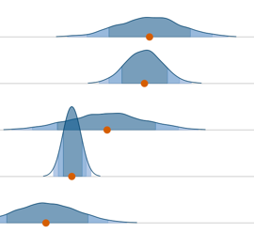
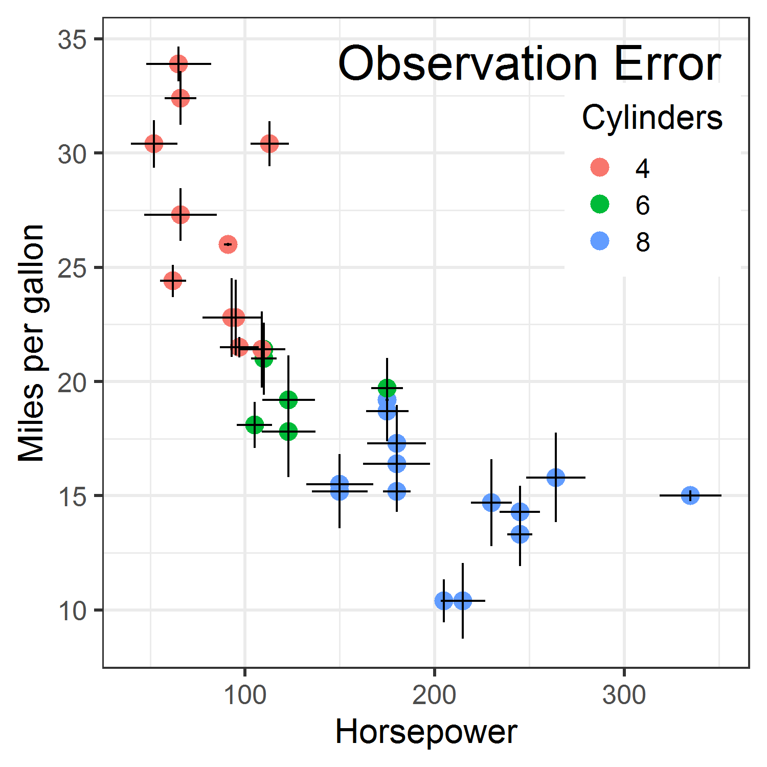
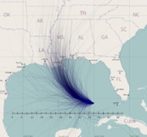
Visualizing Uncertainty
Michael Friendly
Psych 6135
http://euclid.psych.yorku.ca/www/psy6135/

Slide 2
Topics
Problems with uncertainty in visualization
Visualizing distributions
“Error bars”
Uncertainty in fitted curves
Hypothetical outcome plots
Cartographic uncertainty

Slide 3
Sources of uncertainty
Where does the uncertainty in statistics come from? There are three main sources:
Data: data can contain random processes, or have missing entries.
Assumptions: model assumptions take plausible values with distributions.
Models: there is choice over the techniques and models we use.
Different analysts may choose different methods, yielding different estimates.

Slide 4
Problems
Uncertainty is fundamental to data analysis & models
data: IQR, std dev., std error, … (variation)
assumptions: we assume some distribution for errors, e.g., ε ~ N(0, σ²), independent with constant variance
models:
classical: confidence intervals, p-values;
Bayesian: credible intervals, posterior distributions
In data graphics,
Easy to show “fit” – means, regression estimates, …
Harder to show the uncertainty in these numbers

Slide 5
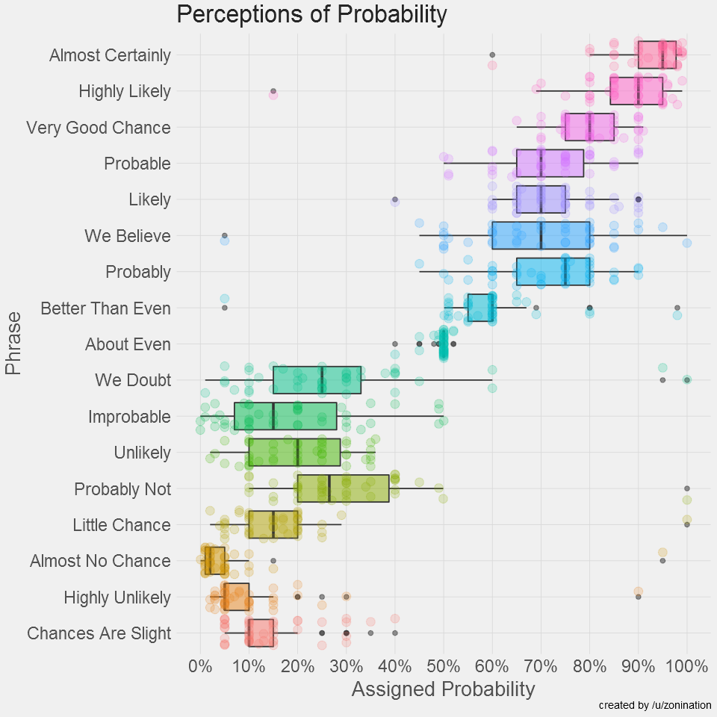
How people view “probability”
What makes this graph successful?
Note the wide range of variability (uncertainty) in the estimates:
“about even” vs. “we believe”

Slide 6
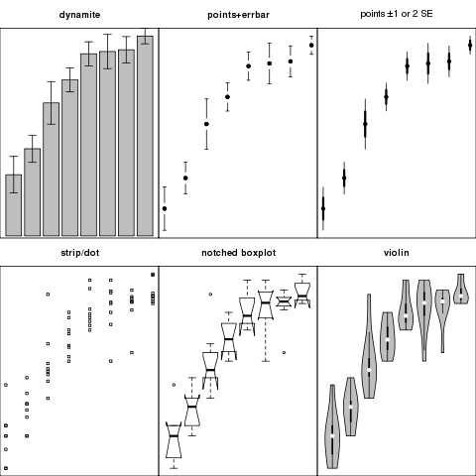
Comparing groups: Summary + Uncertainty
Six different graphs for comparing groups in a one-way design
which group means differ?
equal variability?
distribution shape?
what do error bars mean?
unusual observations?
Never use dynamite plots
Always explain what error bars mean
Consider tradeoff between summarization & exposure

Slide 7
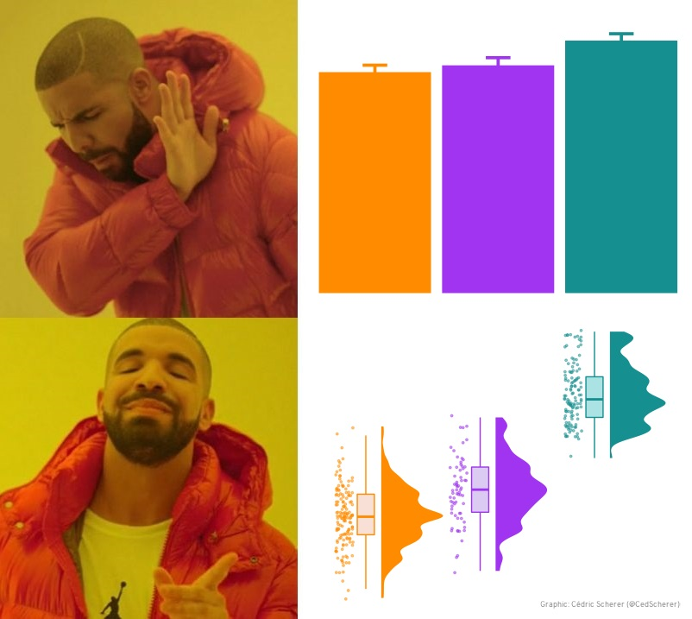
Don’t dynamite me!
rage
joy

Slide 8
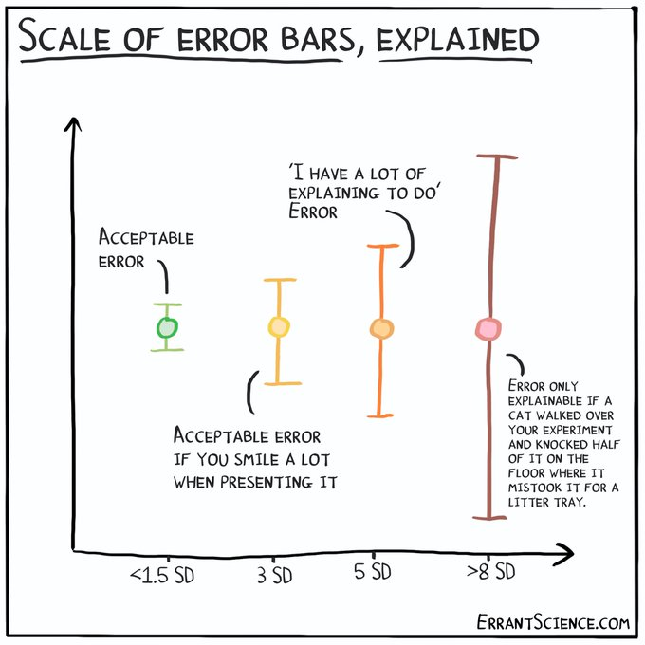
Error bars: When should I worry?

Slide 9
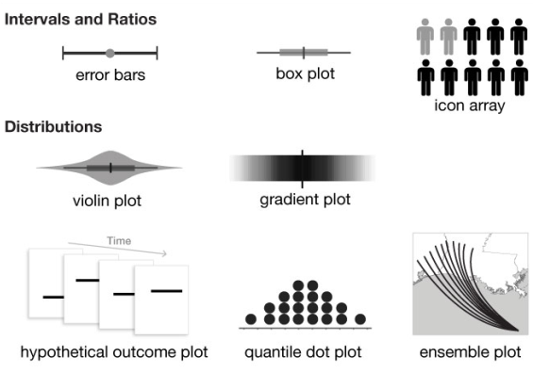
Graphical annotations for uncertainty
From: Padilla, Kay & Hullman (2021), Uncertainty Visualization, DOI: 10.1002/9781118445112.stat08296

Slide 10
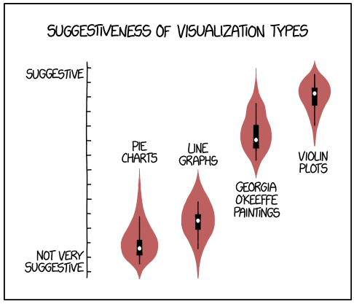
Visualizing distributions
From: https://xkcd.com/1967/

Slide 11
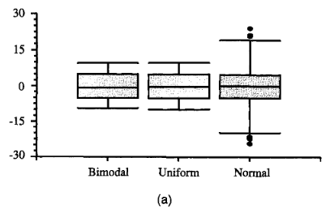
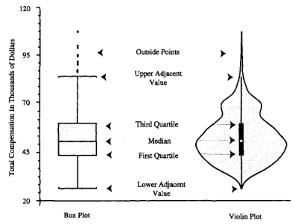
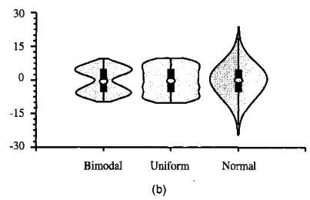
Violin plots
Boxplots are great for ~ normal data
Shows center, spread, outliers
Violin plots add a (reflected) density curve to show the shape of the distribution
Hintze & Nelson (1998), American Statistician, 52:2, 181-184

Slide 12
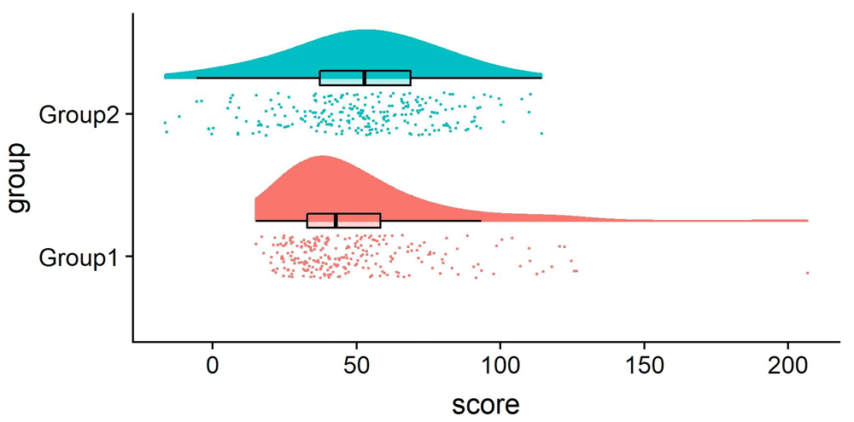
Raincloud plots
Raincloud plots are similar, but also show the observations as jittered points
Allen M, Poggiali D, Whitaker K et al. Raincloud plots: a multi-platform tool for robust data visualization [version 2]. Wellcome Open Res 2021, 4:63 (doi: 10.12688/wellcomeopenres.15191.2)

Slide 13
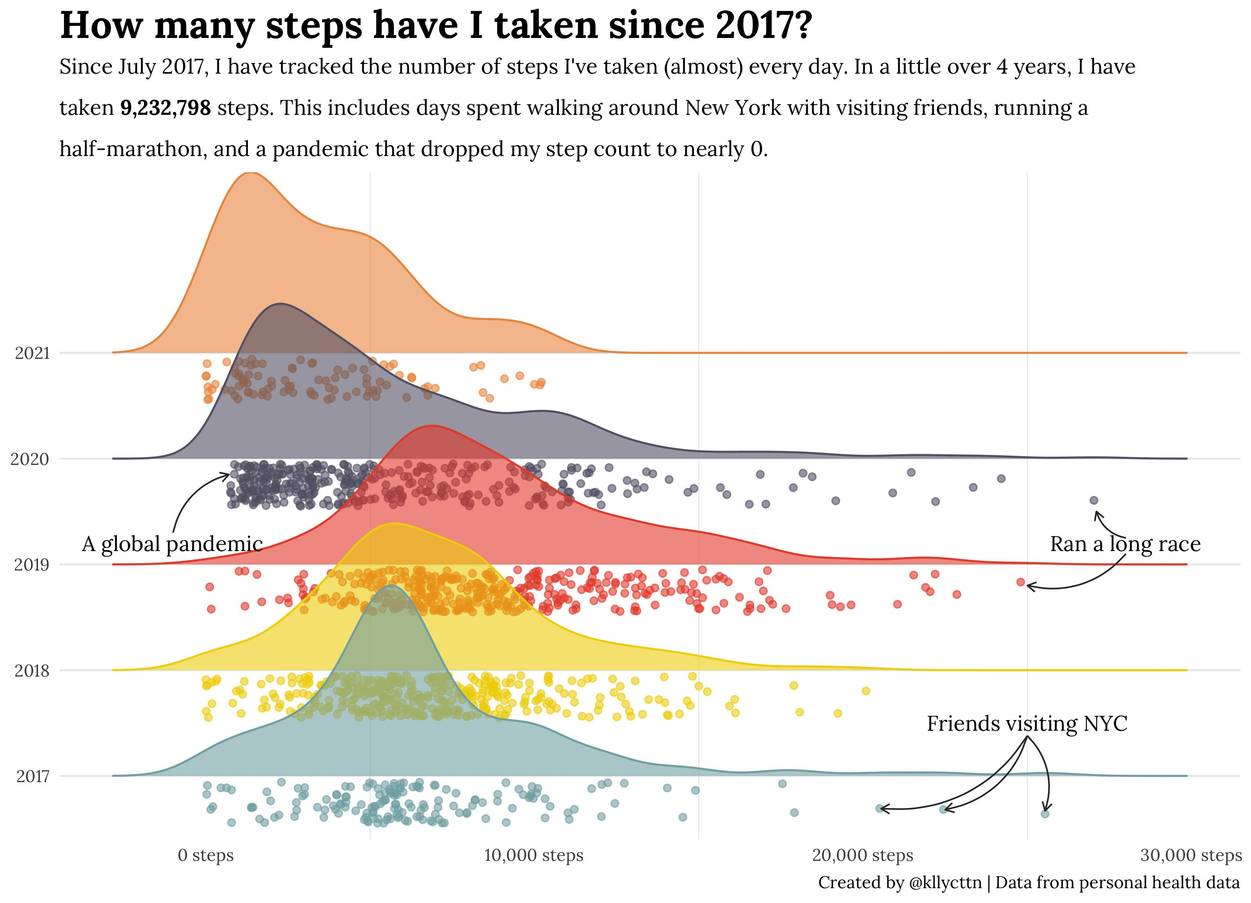

Slide 14
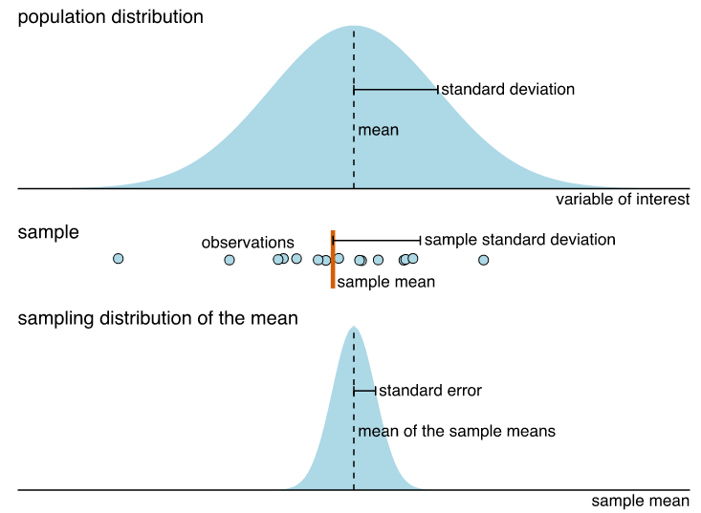
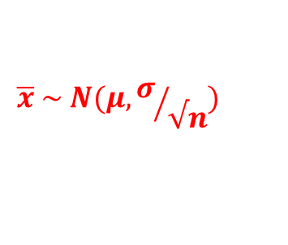
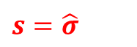
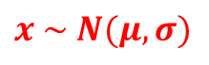
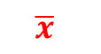
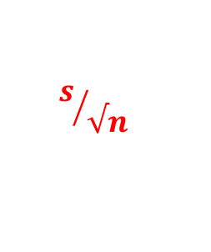
Key ideas of σtatistical σampling
μ
$$x \sim N(μ, σ)$$
σ
$$\overline{x}$$
$$s=\hat{σ}$$
$$\overline{x} \sim N(μ, σ/{√n})$$
$$s/{√n}$$
μ
From: Claus Wilke (2021), Fundamentals of Data Visualization, https://clauswilke.com/dataviz/ , Ch 16

Slide 15
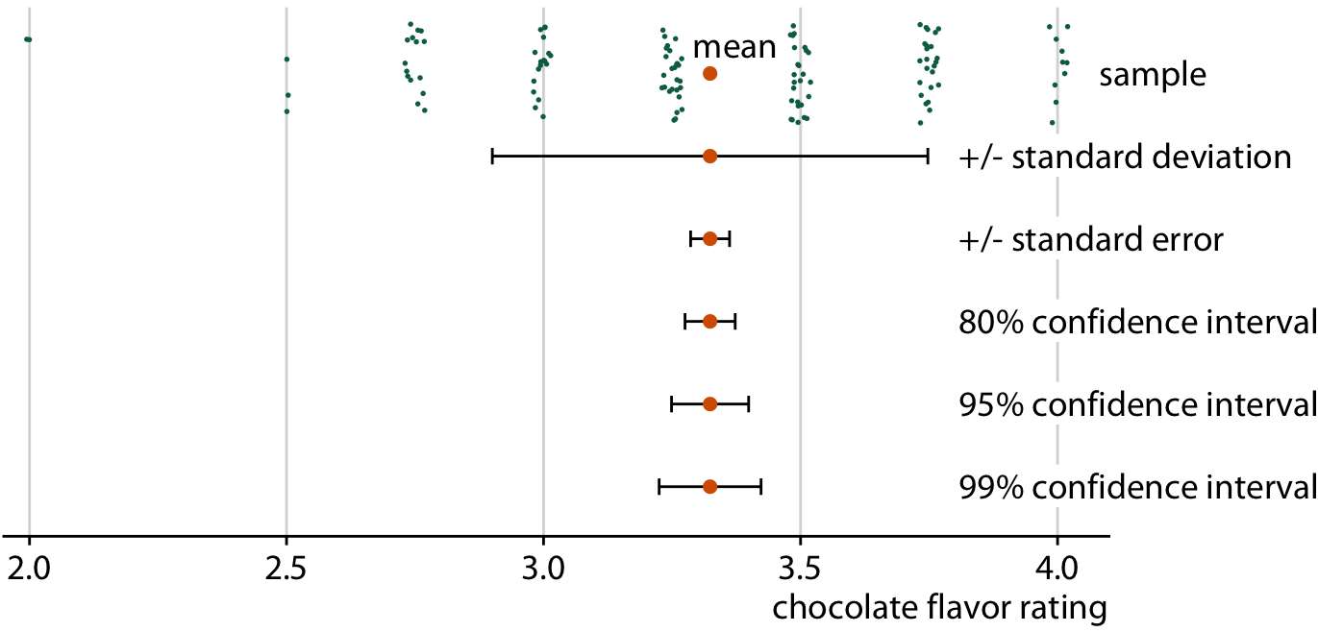
Visualizing distributions: Error bars
There are many ways to show variability in a single sample
Expert ratings of 125 chocolate bars manufactured in Canada
From: Claus Wilke (2021), Fundamentals of Data Visualization, https://clauswilke.com/dataviz/ , Ch 16

Slide 16
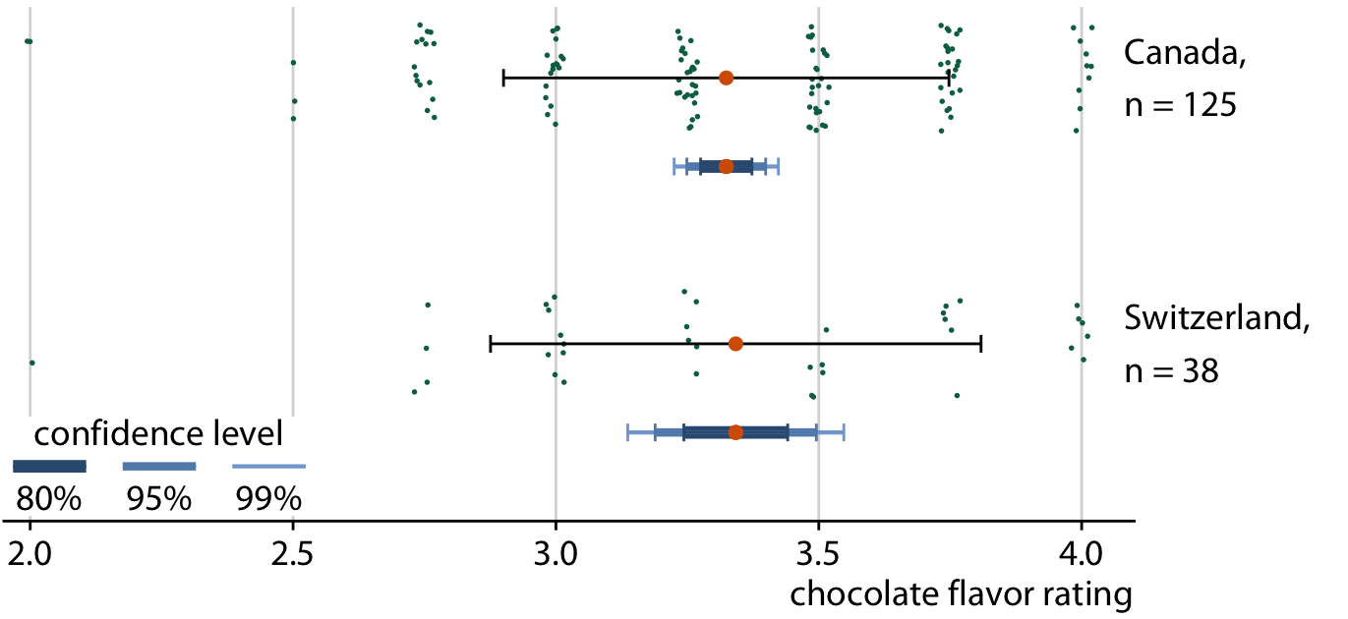
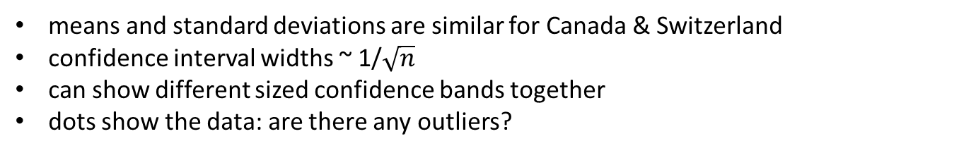
Comparing distributions: Sample size
means and standard deviations are similar for Canada & Switzerland
confidence interval widths ~ 1/$\sqrt{n}$
can show different sized confidence bands together
dots show the data: are there any outliers?
From: Claus Wilke (2021), Fundamentals of Data Visualization, https://clauswilke.com/dataviz/ , Ch 16

Slide 17
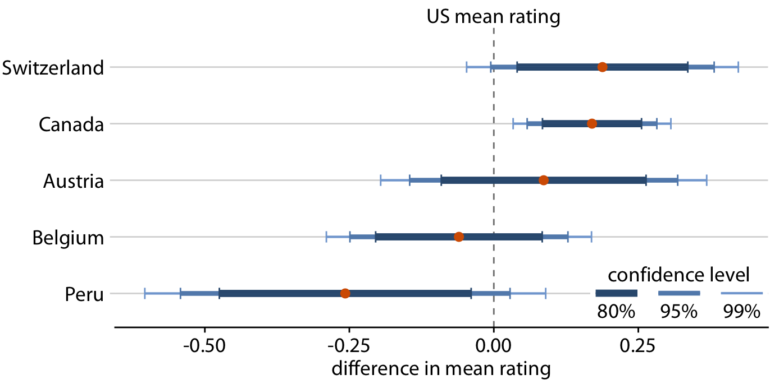
Comparing distributions: Contrasts
For comparison of one group to all others, plot the difference directly
Easy to see which differences exclude 0, at what confidence level
✓
✓✓✓
✗
✗
✗
From: Claus Wilke (2021), Fundamentals of Data Visualization, https://clauswilke.com/dataviz/ , Ch 16

Slide 18
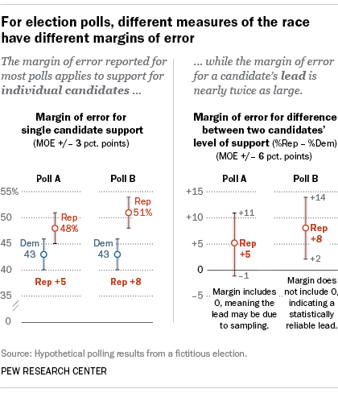
Intervals: Direct vs. Differences
The standard error for the difference between two means is always larger than the standard error of either mean

Slide 19
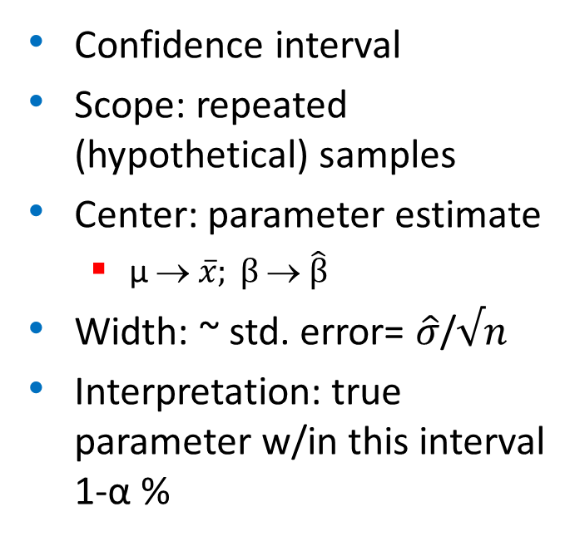
What kind of intervals?
Frequentist
Bayesian
Confidence interval
Scope: repeated (hypothetical) samples
Center: parameter estimate
μ → $\overline{x}; β $ $\hat{β}$
Width: ~ std. error= $\hat{σ}$/$√n$
Interpretation: true parameter w/in this interval 1-α %
Credibility interval
Scope: repeated draws from the posterior distribution
Center: median of posterior distribution
Width: MAD sd of posterior
Interpretation: Given prior, expect parameter w/in this interval 1-α %

Slide 20
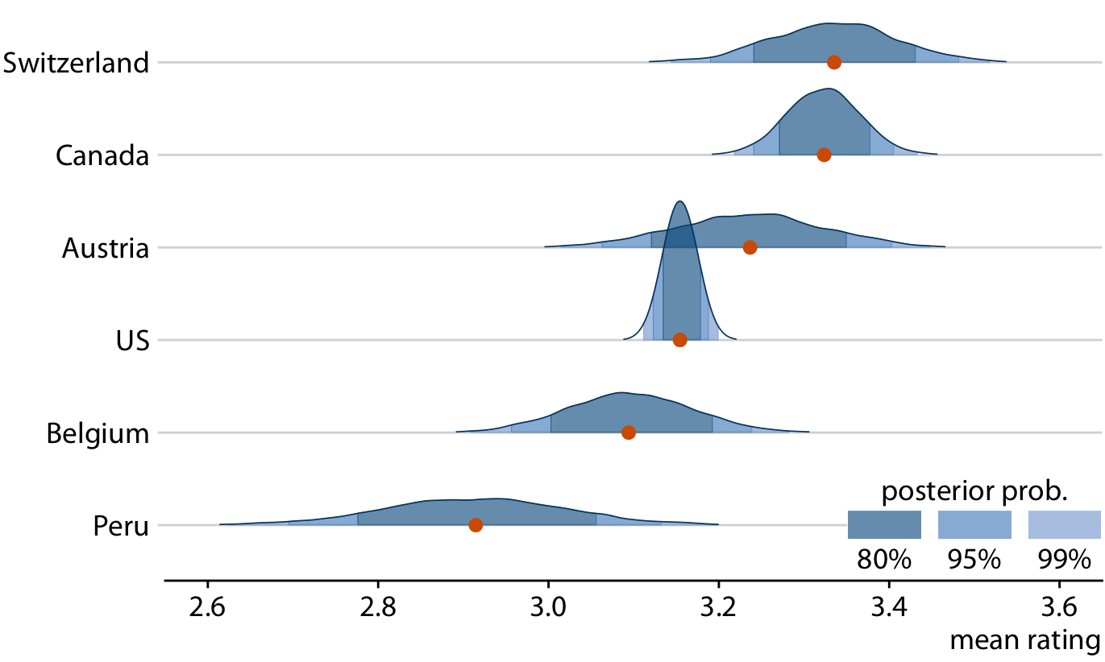
Bayesian intervals

Slide 21
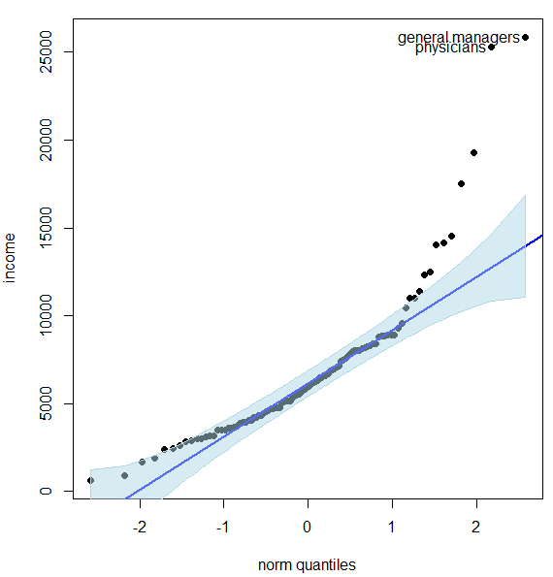
Uncertainty in fits & curves
QQplots
Model fit plots

Slide 22
QQ plots
How close is my data to a {Normal | exponential | χ2} distribution?
There are lots of statistical tests, but these don’t tell why or where a distribution is rejected.
These tests are also overly sensitive to small departures
Plot observed Quantiles vs. theoretical Quantiles
If observed ~ theoretical with slope = 1, OK
Confidence bands help to identify outliers
Use cases:
Is a single variable reasonably normally distributed?
Are the residuals from my linear model Normal?
Outliers in multivariate data? D² ~ χ2 → chisq QQ plot

Slide 23
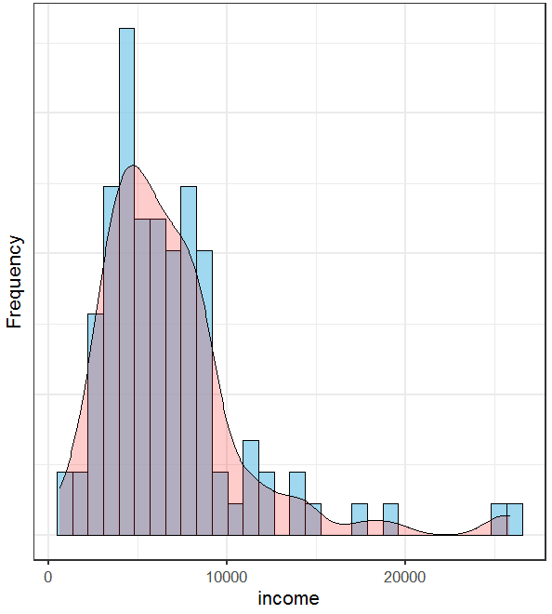
Prestige data: income
Income is clearly positively skewed.
(But normality is not required for predictors.)
This shows up as a U-shaped pattern
The 95 % confidence band shows greatest departure in the upper tail

Slide 24
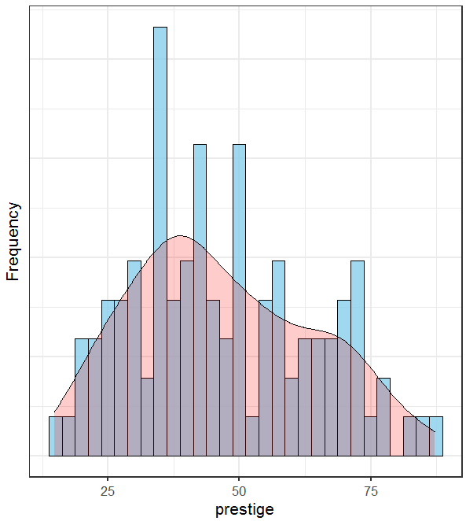
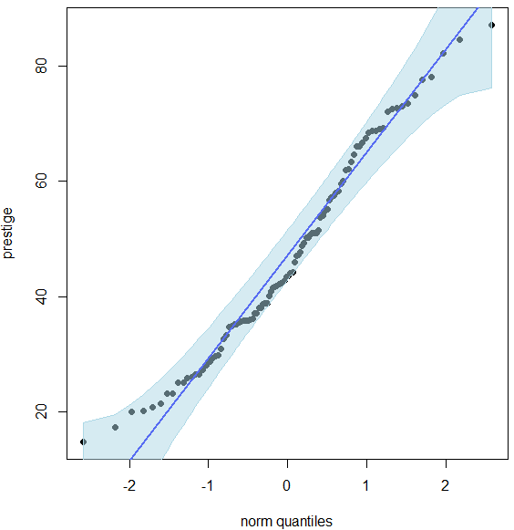
Prestige data: prestige
Occupational prestige doesn’t look precisely normal, but not that bad.
The 95% confidence band includes all the observations

Slide 25
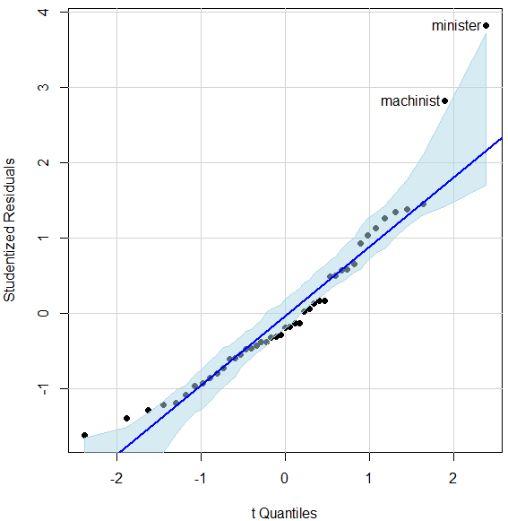
Prestige data: residuals
Normality of residuals is more important for linear models
Some small evidence of + skew
Confidence bands help to identify potential outliers – badly fitted pts
qqPlot(lm(prestige ~ income + education + type, data=Duncan))

Slide 26
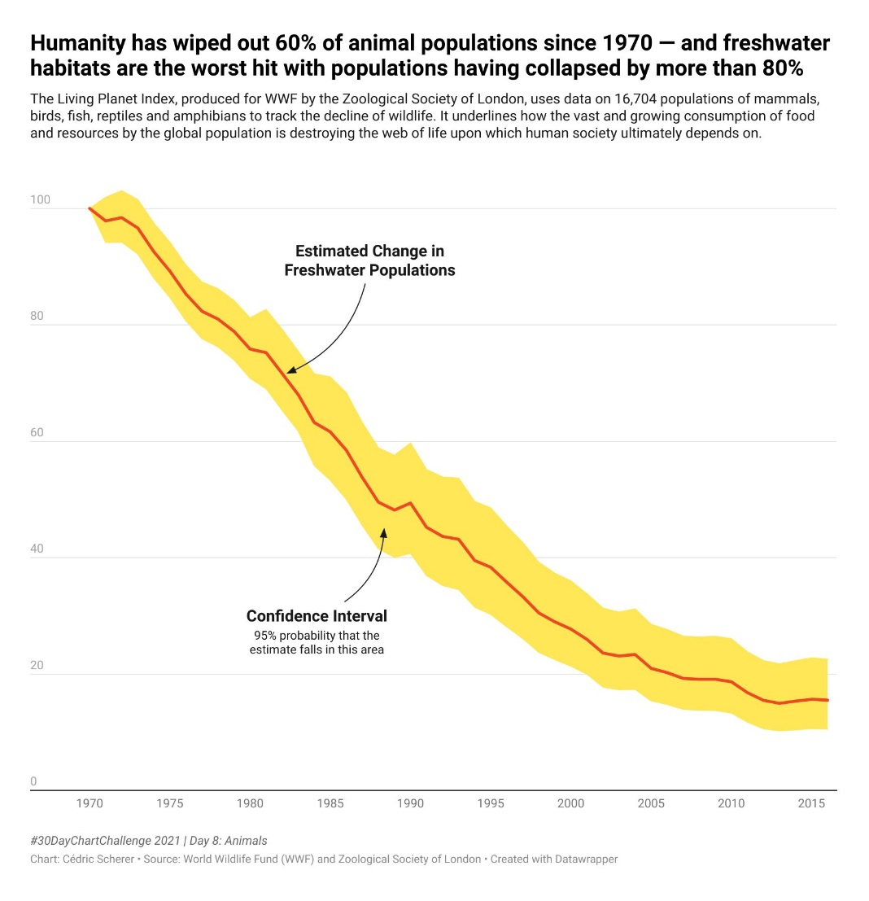
Curves + Uncertainty
Cederic Scherer used this graphic to argue about the decline of animal & freshwater populations.
Details aside, the confidence band gives visual evidence that the decline is systematic.
From: https://twitter.com/CedScherer/status/1380211291466399744

Slide 27
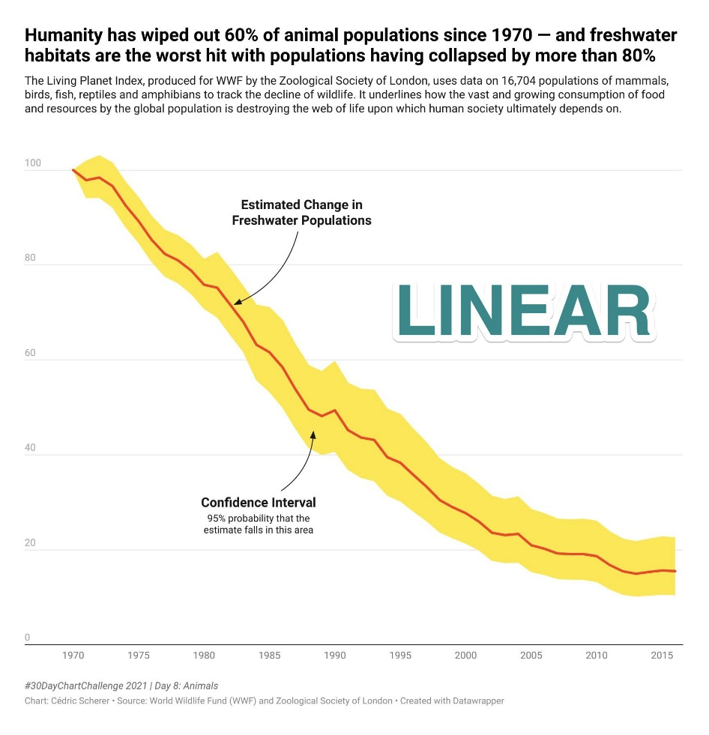
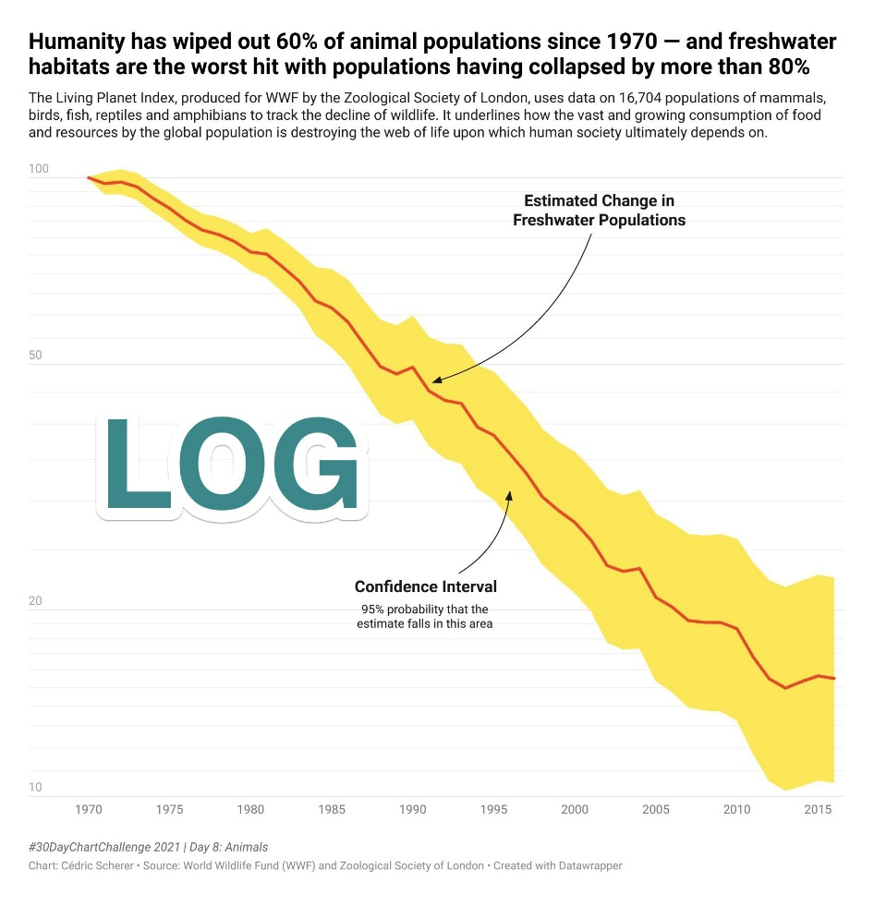
Curves + Uncertainty: Scale
Arguably, percent reduction in animal population should be viewed on a log scale.
Transformed uncertainty intervals are here the logs of the Upper/Lower levels

Slide 28
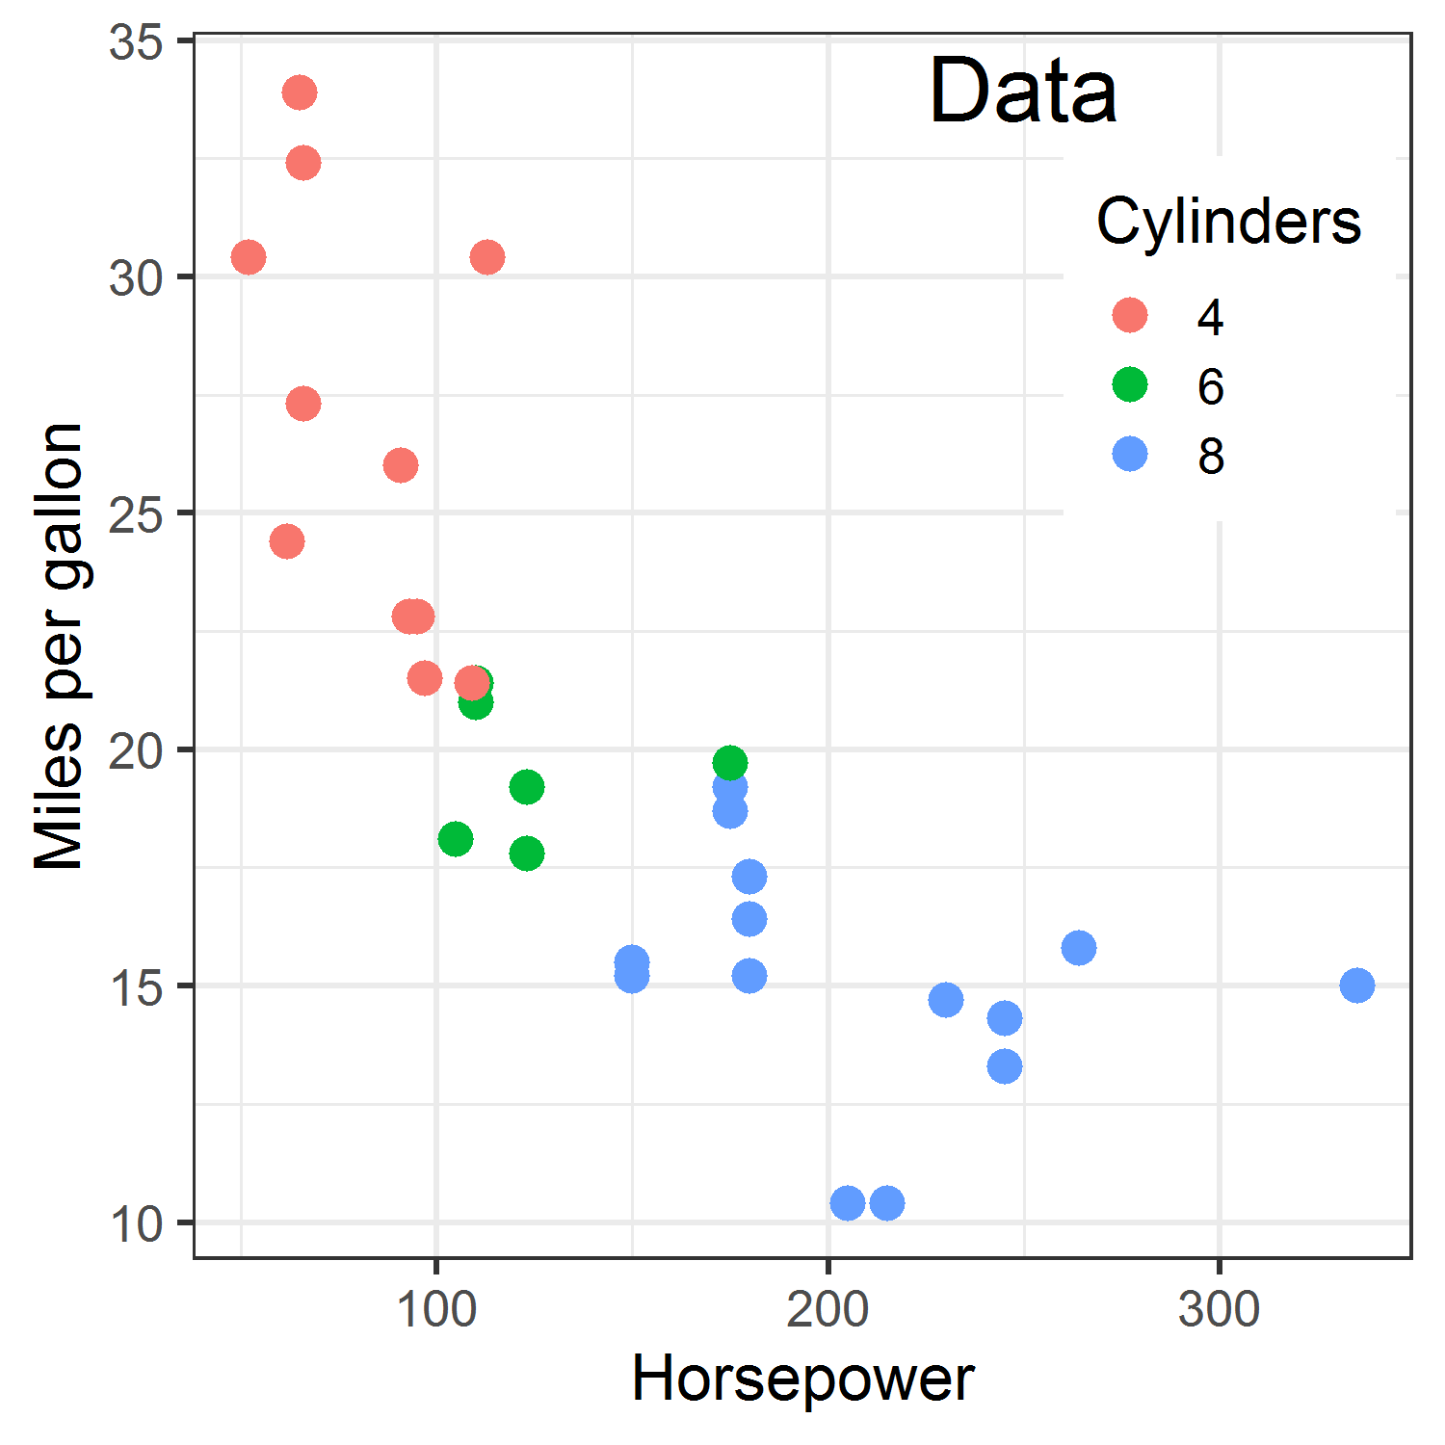
Fitted curves
Data on gas mileage of Motor Trend 1974 cars
Sources of uncertainty:
Observations: measurement error in MPG and/or HP?
Model form: Linear? Quadratic? Interaction with cylinders
Model fit uncertainty: normal theory CIs? Bootstrap? Bayesian?

Slide 29
Measurement uncertainty
Sometimes, we can quantify the uncertainty (“error”) in values of x and or y.
e.g., each point is the average of n>1 cars.
Fitted models allow for errors in y:
y = f(x) + error
and find estimates to minimize error
Most fitted models assume x is measured w/o error.
Big problem if error ~ f(x, other xs)

Slide 30
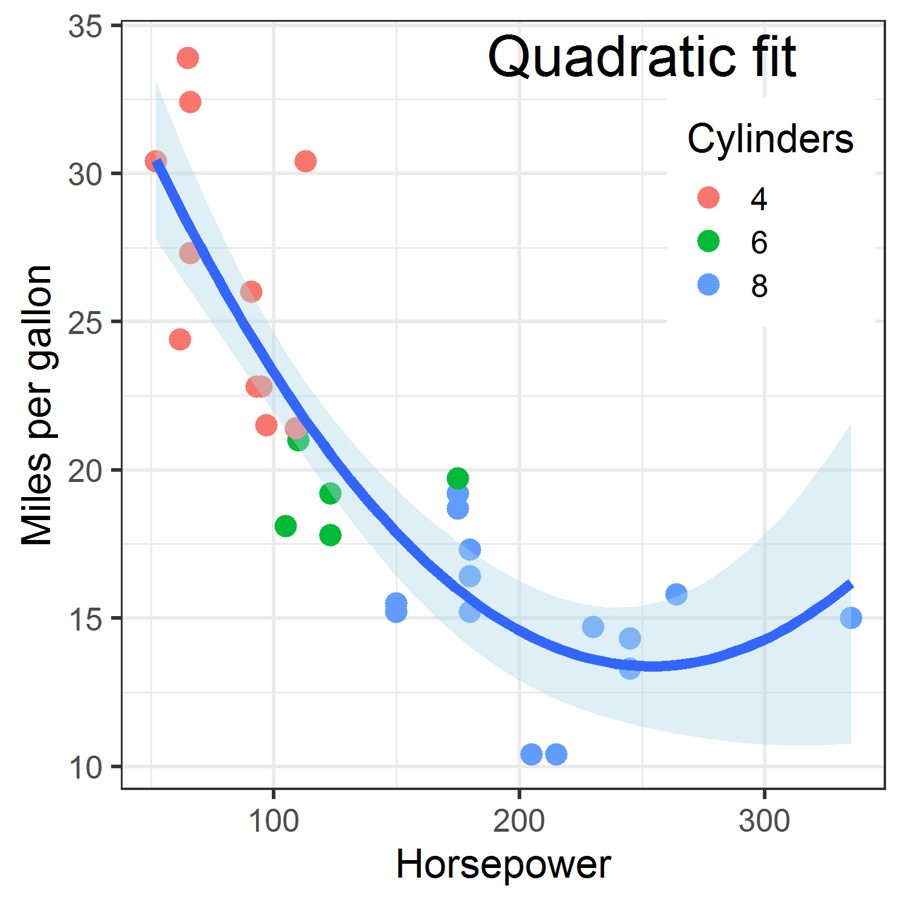
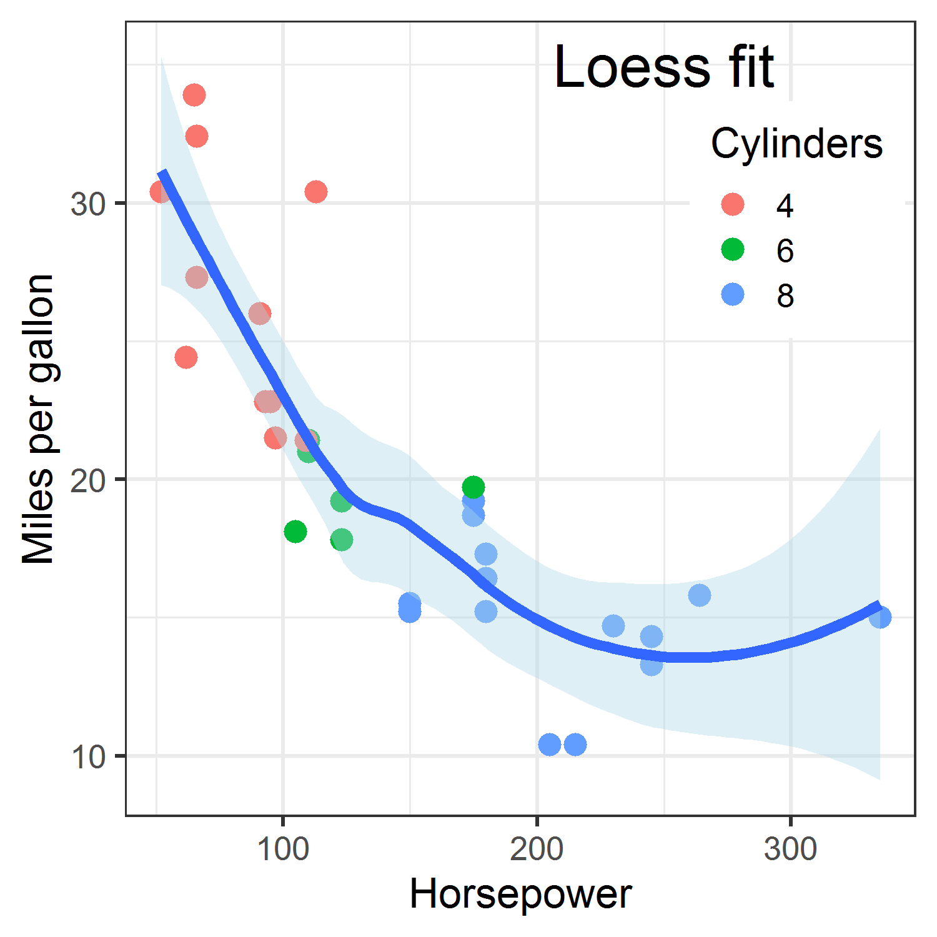
Model forms: nonlinear fits
When a relation is clearly non-linear, we can fit alternative models.
The CI bands tell us where the data is too thin to rely on the predicted value.
p1 + geom_smooth(method = lm, formula = y~poly(x,2), …)
p1 + geom_smooth(method = loess, formula = y~x, …)

Slide 31
Fitted curves: smoothers
In each case, the confidence band gives visual evidence for uncertainty of the predicted values.
But, uncertainty may be expressed differently.
a formula for std. error based on normal/large sample theory
envelope of (normal) simulations
Bayesian predictive distribution

Slide 32
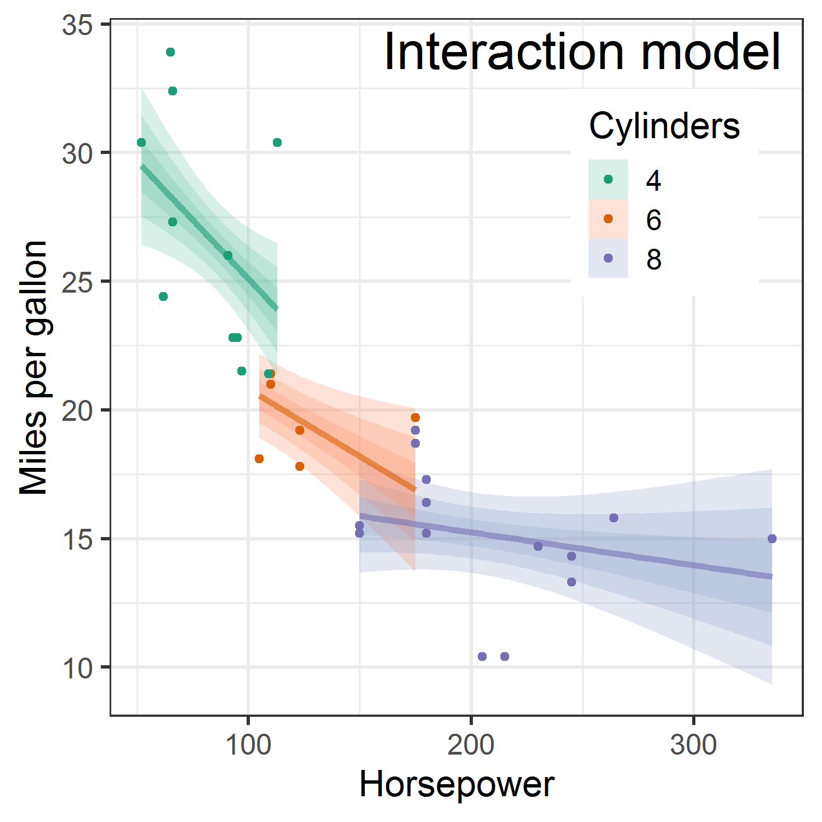
Interaction models
The non-linear relation between hp & mpg can (arguably) be better explained by a model that allows different slopes for 4, 6, 8 cylinders.
The graph shows normal theory Cis at 95%, 90%, and 80% for each cylinder level

Slide 33
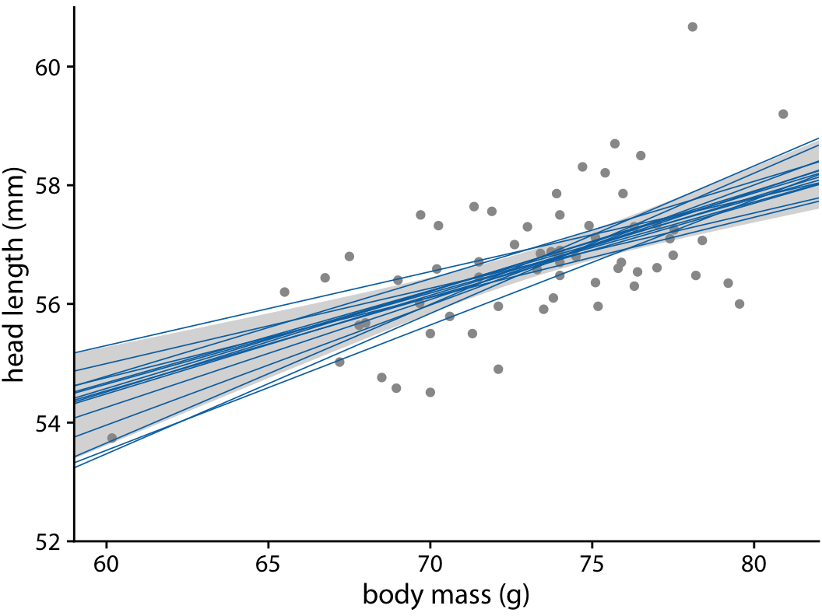
Simulations to convey uncertainty
Simulating fits from the data (e.g., bootstrap, Bayesian estimation) shows the variability. Doesn’t rely on classical, normal theory.

Slide 34
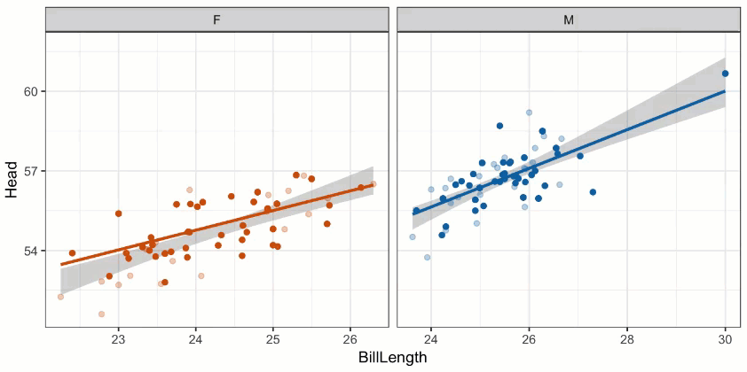
Animation to understand uncertainty
All assessments of uncertainty rely on a comparison: data vs. could have been
Sampling distributions, simulations, Bayesian posterior distributions, …
Sometimes useful to appreciate the variability with animated graphics

Slide 35
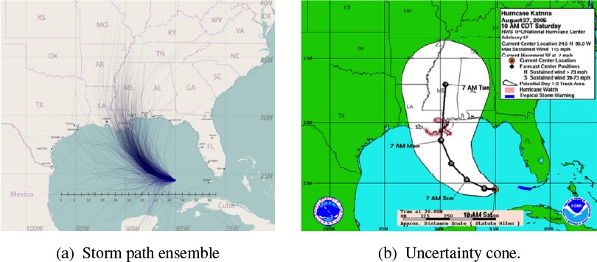
Geographic uncertainty
Predicting the path of hurricanes:
Given what we can measure today (location, wind speed, direction, …) where is this hurricane likely to be in 1 day, 3 days, 5 days?
Most forecasts are based on an ensemble of predictions, representing the uncertainty in initial conditions, model physics, …
Often this is represented as a “cone of uncertainty”

Slide 36
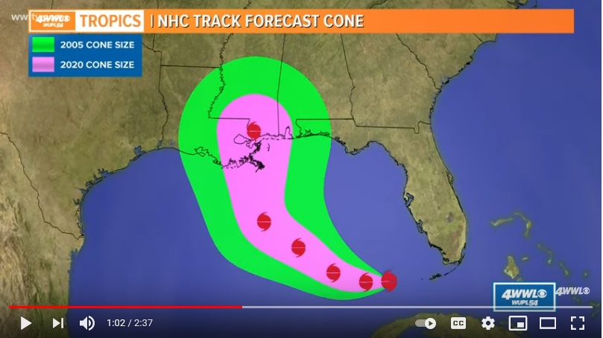
What is the Cone of Uncertainty?
As seen on TV:
The center is meant to track the average prediction, either over models or history
The cone size generally represents some “2/3 confidence interval”
Does this mean I am safe if I lived in Tallahassee FL in 2005? 2020?
From: https://www.youtube.com/watch?v=nE6XaHtpm04

Slide 37
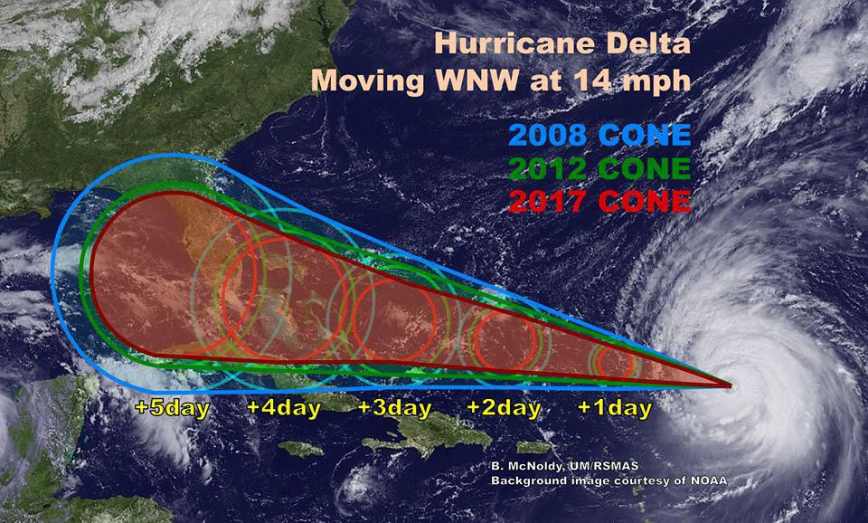
The Incredible Shrinking Cone
Changes in presumed accuracy are often shown as below
The cone represents the probable track of the center of a tropical cyclone, formed by enclosing the area swept out by a set of circles along the forecast track (at 12, 24, 36 hours, etc).
The size of each circle is set so that two-thirds of historical official forecast errors over a 5-year sample fall within the circle.

Slide 38
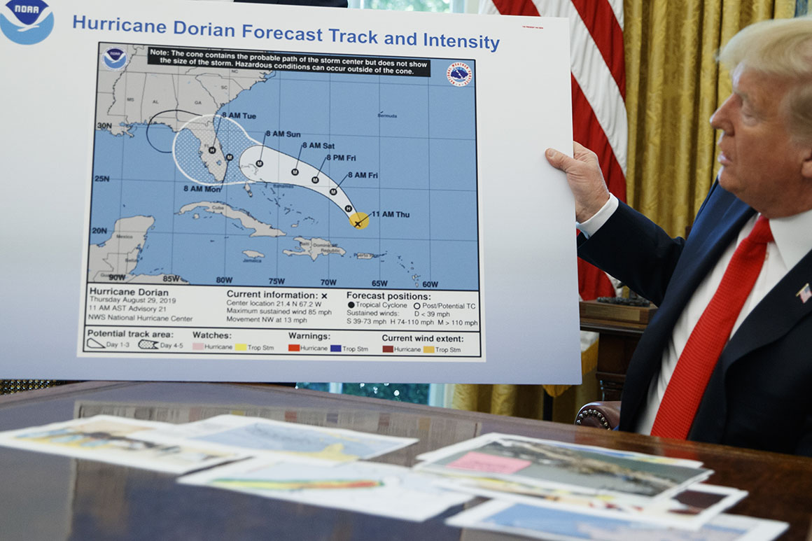
Sharpiegate
In Sept. 2019, Donald Trump went live with “extrapolated” predictions of the path of Hurricane Dorian.
He had earlier predicted it would hit Alabama & Georgia.
Let it be said, let it be written (with a sharpie)
sharpie extrapolation
model extrapolation
model forecast
From: https://www.theguardian.com/us-news/2019/sep/05/trump-hurricane-dorian-alabama-map-sharpiegate

Slide 39
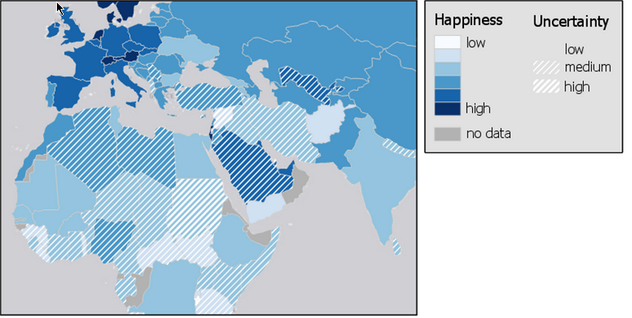
Coding maps for uncertainty
In choropleth maps can show uncertainty with another attribute
From: https://www.e-education.psu.edu/geog486/node/693

